Slide 1


22-08-2026
RIPv2 Different CIDR
TALREJA HARSH
A practical guide to configuring RIPv2 across networks with different CIDR subnet blocks

Slide 2
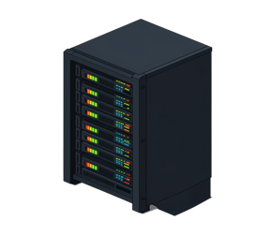
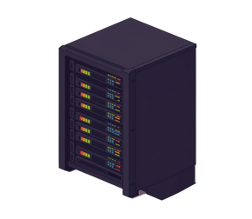


About
RIPv2
Fundamentals
Distance-Vector
VLSM Support
Periodic Updates
Uses hop count as the sole metric, with a maximum of 15 hops before a route is considered unreachable.
Supports CIDR notation and variable-length subnet masks — a major leap beyond RIPv1.
Broadcasts full routing table every 30 seconds to all RIPv2-enabled neighbors.

Slide 3


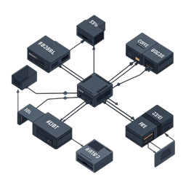
CIDR AND RIPV2 COMPATIBILITY
RIPv2's defining advantage over RIPv1 is its inclusion of the subnet mask in every routing update, enabling true classless routing.
•Same major network can carry multiple subnet sizes simultaneously
•Discontiguous subnets are properly distinguished
•Example: 192.168.0.0/24, 192.168.1.0/25, and 192.168.2.0/26 coexist in one RIPv2 domain

Slide 4

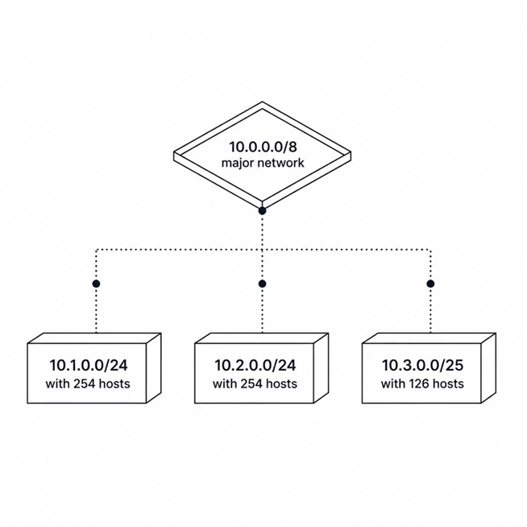

NETWORK CONFIGURATION: SINGLE MAJOR NETWORK
Topology
Major network: 10.0.0.0/8
Subnet 1: 10.1.0.0/24 — 254 usable hosts
Subnet 2: 10.2.0.0/24 — 254 usable hosts
Subnet 3: 10.3.0.0/25 — 126 usable hosts
RIPv2 advertises each subnet with its specific mask — no manual aggregation required at the subnet level.

Slide 5



NETWORK CONFIGURATION: MULTIPLE MAJOR NETWORKS
NETWORK A — 172.16.0.0/16
NETWORK B — 192.168.0.0/16
•172.16.1.0/24 — STANDARD /24 SUBNET, 254 HOSTS
•172.16.2.0/25 — HALF-SIZE SUBNET, 126 HOSTS
•192.168.1.0/24 — STANDARD /24 SUBNET, 254 HOSTS
•192.168.2.0/26 — QUARTER-SIZE SUBNET, 62 HOSTS
RIPV2 HANDLES BOTH MAJOR NETWORKS INDEPENDENTLY, PROPAGATING EACH SUBNET'S EXACT PREFIX LENGTH WITH FULL CIDR SUPPORT — NO CLASSFUL ASSUMPTIONS MADE.

Slide 6

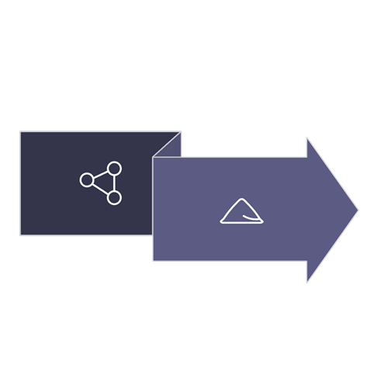



MANUAL SUMMARIZATION IS A POWERFUL TOOL FOR REDUCING ROUTING TABLE SIZE AND CUTTING UNNECESSARY UPDATE TRAFFIC ACROSS THE NETWORK
10.0.0.0/22
ROUTE AGGREGATION WITH CIDR
•10.1.0.0/24 + 10.2.0.0/24 + 10.3.0.0/24 + 10.4.0.0/24 → SUMMARIZE AS 10.0.0.0/22
•ADVERTISE THE SUMMARY ROUTE INSTEAD OF INDIVIDUAL /24 ENTRIES
•REDUCES CONVERGENCE OVERHEAD AND TABLE BLOAT AT BOUNDARY ROUTERS
10.1/24 • 10.2/24 • 10.3/24 • 10.4/24
ALWAYS VERIFY THAT SUMMARIZED BLOCKS DON'T ACCIDENTALLY INCLUDE UNINTENDED SUBNETS BEFORE ADVERTISING.

Slide 7
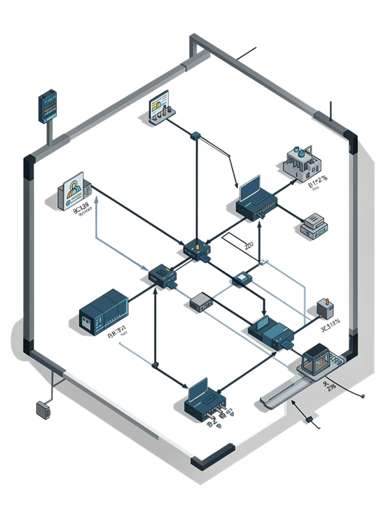


Metric Calculation Across CIDR Blocks
15
1
MAX HOP COUNT
HOP COST
Routes beyond 15 hops are marked unreachable (metric = 16)
BOTH 10.1.0.0/24 AND 10.1.0.0/25 COST EXACTLY 1 HOP FROM SOURCE
0
CIDR INFLUENCE
SUBNET MASK SIZE HAS ZERO EFFECT ON THE METRIC — ONLY REACHABILITY MATTERS

Slide 8



CONFIGURATION EXAMPLE: ROUTER SETUP
ROUTER A
ROUTER B
ROUTER RIP
VERSION 2
NETWORK 10.0.0.0
NETWORK 172.16.0.0
NO AUTO-SUMMARY
ROUTER RIP
VERSION 2
NETWORK 10.0.0.0
NETWORK 192.168.0.0
NO AUTO-SUMMARY
RIPV2 AUTOMATICALLY INCLUDES ALL SUBNETS WITHIN EACH DECLARED NETWORK. THE NO AUTO-SUMMARY COMMAND IS CRITICAL — IT PREVENTS CLASSFUL AGGREGATION AND ENSURES ALL CIDR PREFIXES ARE ADVERTISED WITH THEIR CORRECT SUBNET MASKS.

Slide 9

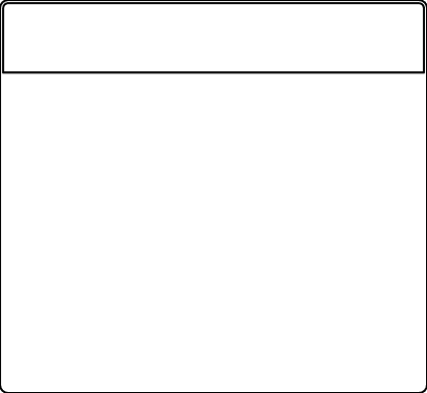
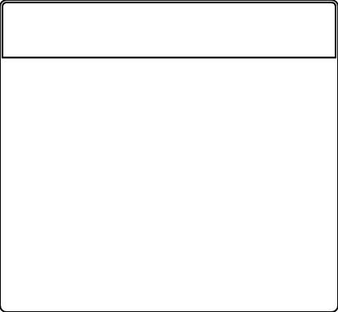
COMMON PITFALLS
1
2
3
OVERLAPPING CIDR BLOCKS
MISSING NETWORK STATEMENTS
DISCONTIGUOUS NETWORKS
OVERLAPPING SUBNETS CAUSE ROUTING LOOPS AND BLACK HOLES. AUDIT YOUR ADDRESS PLAN CAREFULLY — ENSURE EVERY SUBNET IS UNIQUE AND NON-OVERLAPPING ACROSS ALL MAJOR NETWORKS.
ANY SUBNET NOT COVERED BY A NETWORK STATEMENT WILL NOT BE ADVERTISED. ENGINEERS OFTEN FORGET SECONDARY OR LOOPBACK SUBNETS, CAUSING SILENT REACHABILITY FAILURES
RIPV2 AUTO-SUMMARIZES AT MAJOR NETWORK BOUNDARIES UNLESS NO AUTO-SUMMARY IS CONFIGURED. DISCONTIGUOUS NETWORKS WILL SILENTLY MERGE ROUTES, BREAKING VLSM DESIGNS.

Slide 10
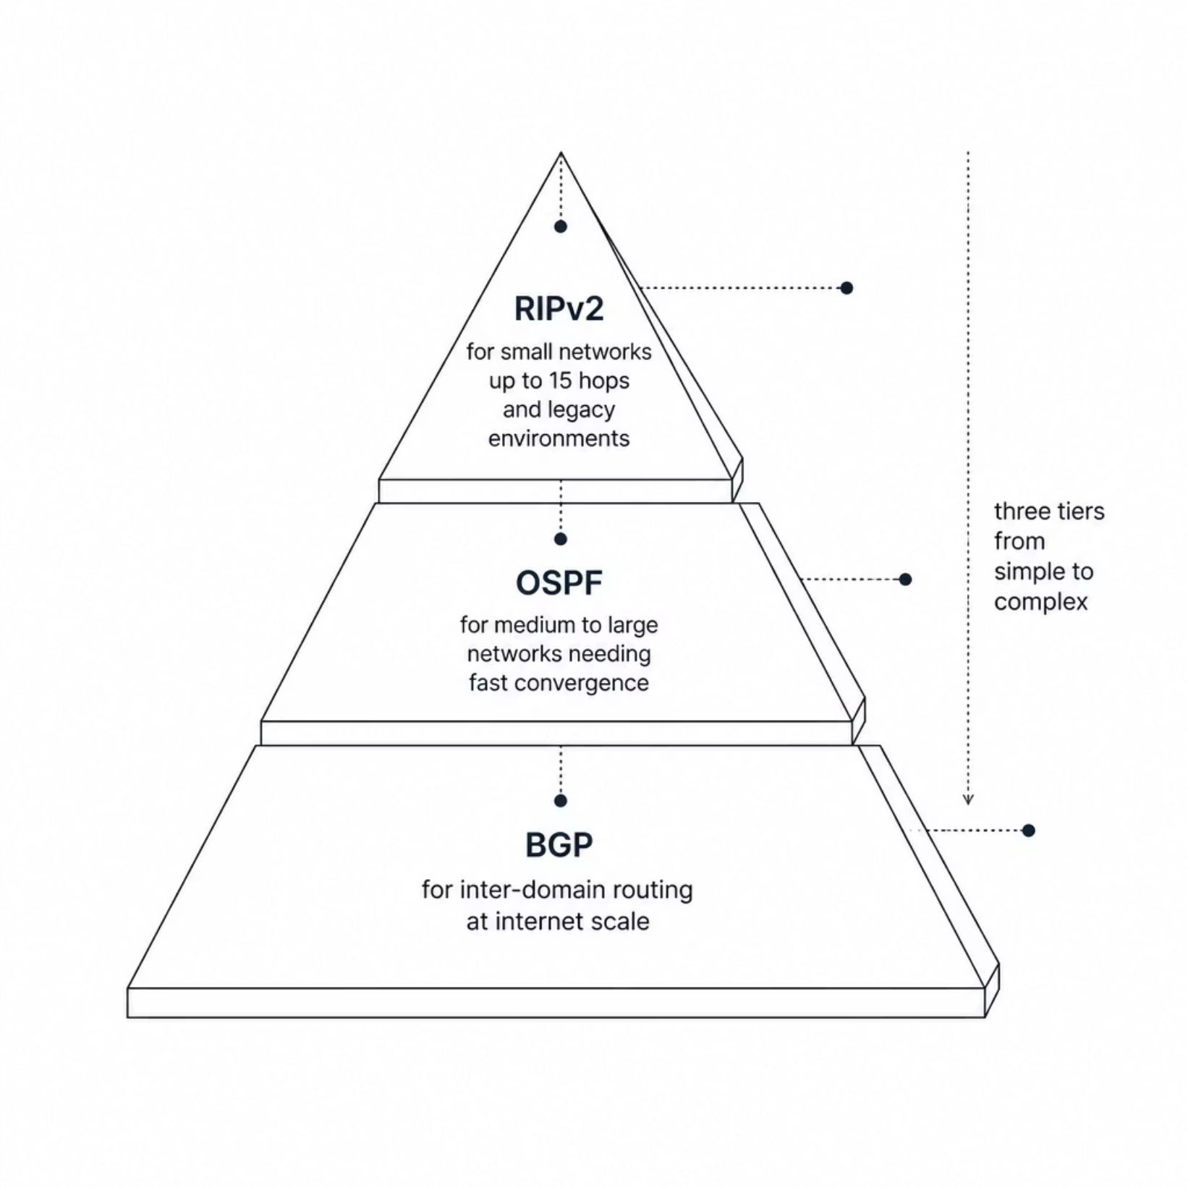
WHEN TO USE RIPV2 WITH CIDR
RIPV2 REMAINS A VALID CHOICE IN THE RIGHT CONTEXT. KNOW ITS BOUNDARIES BEFORE COMMITTING TO A DEPLOYMENT.
•SMALL TO MEDIUM NETWORKS (≤15 HOPS) WITH FLEXIBLE SUBNET REQUIREMENTS
•LEGACY ENVIRONMENTS WHERE RIPV2 IS ALREADY OPERATIONAL AND MIGRATION COST IS HIGH
•FOR NETWORKS EXCEEDING 15 HOPS OR REQUIRING FAST CONVERGENCE, EVALUATE OSPF OR BGP INSTEAD

Slide 11



2026
THANK YOU
For your attention

